Slide 1


ISPPPD WS1: Evaluating Vaccine Impact using Time Series Data
Dan Weinberger, PhD
Epidemiology of Microbial Diseases
Yale School of Public Health

Slide 2
Acknowledgements
The development of this workshop was supported by a grant from the Bill and Melinda Gates Foundation
The material in this workshop was jointly developed with
Dr. Kayoko Shioda (Yale/Emory)
Iris Artin
Dr Cristiana Toscano (PAHO/Universidade Federal de Goiás)
Dr. Lucia Oliveria (PAHO)
Dr. Jackie Kleynhans (NICD/South Africa)
Dr. Nuredin Mohammed (MRC/Gambia)
Dr. Lone Simonsen (Roskilde)
Dr. Rob Taylor (Sage Analytica)
Dr. Cynthia Schuck-Paim (Sage Analytica)
Dr. Christian Bruhn
The WHO working group on the use of administrative data to evaluate PCV impact (Fernanda Lessa (CDC), Jennifer Loo Farrar (CDC), Tomoka Nakamura (WHO), Adam Cohen (WHO/CDC)

Slide 3
Conflicts of interest
DMW is PI on grants from Merck and Pfizer to Yale
DMW has consulted for Pfizer, Merck, GSK, Affinivax and Matrivax, all of whom are producing or developing pneumococcal vaccines

Slide 4
Structure of the workshop
Presentation (first hour):
What do we mean by ‘vaccine impact’?
Common types of analyses and their limitations
Hands on:
Setting up and evaluating an interrupted time series
Example of ITS: The Gambia
Example of Synthetic Controls analysis: South Africa

Slide 5
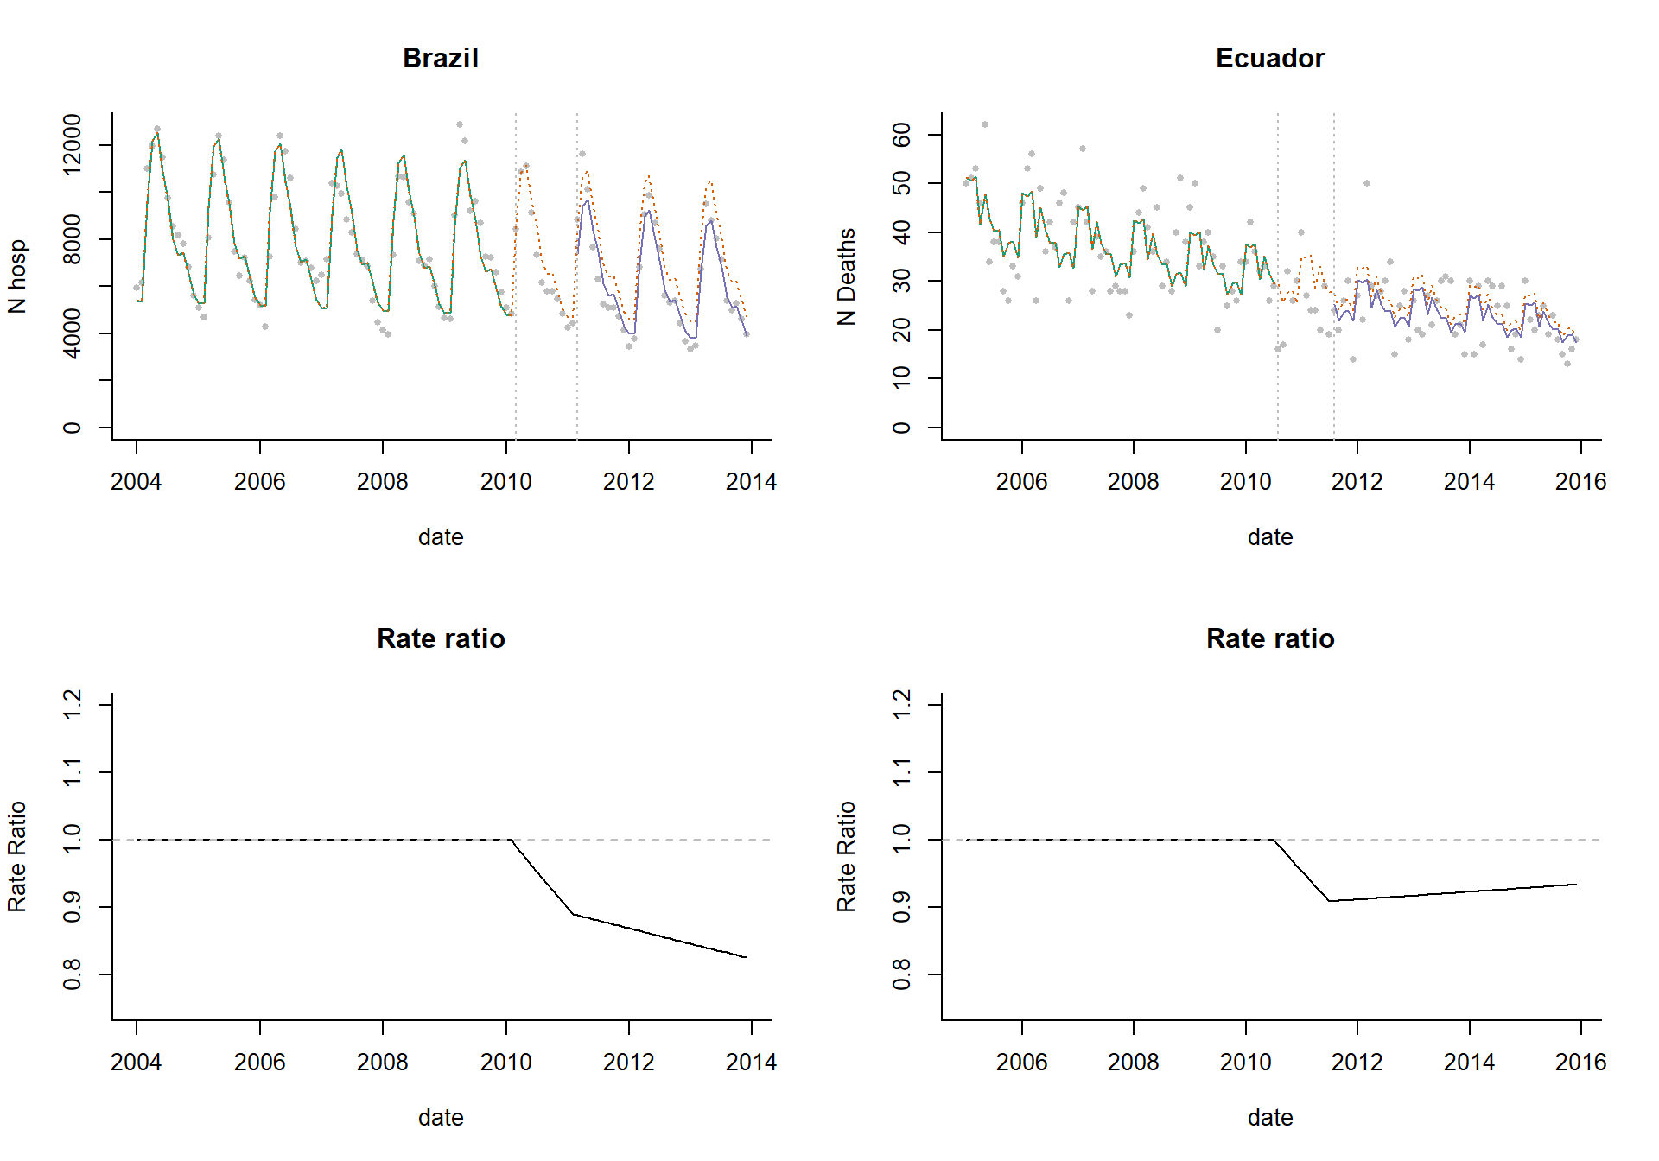
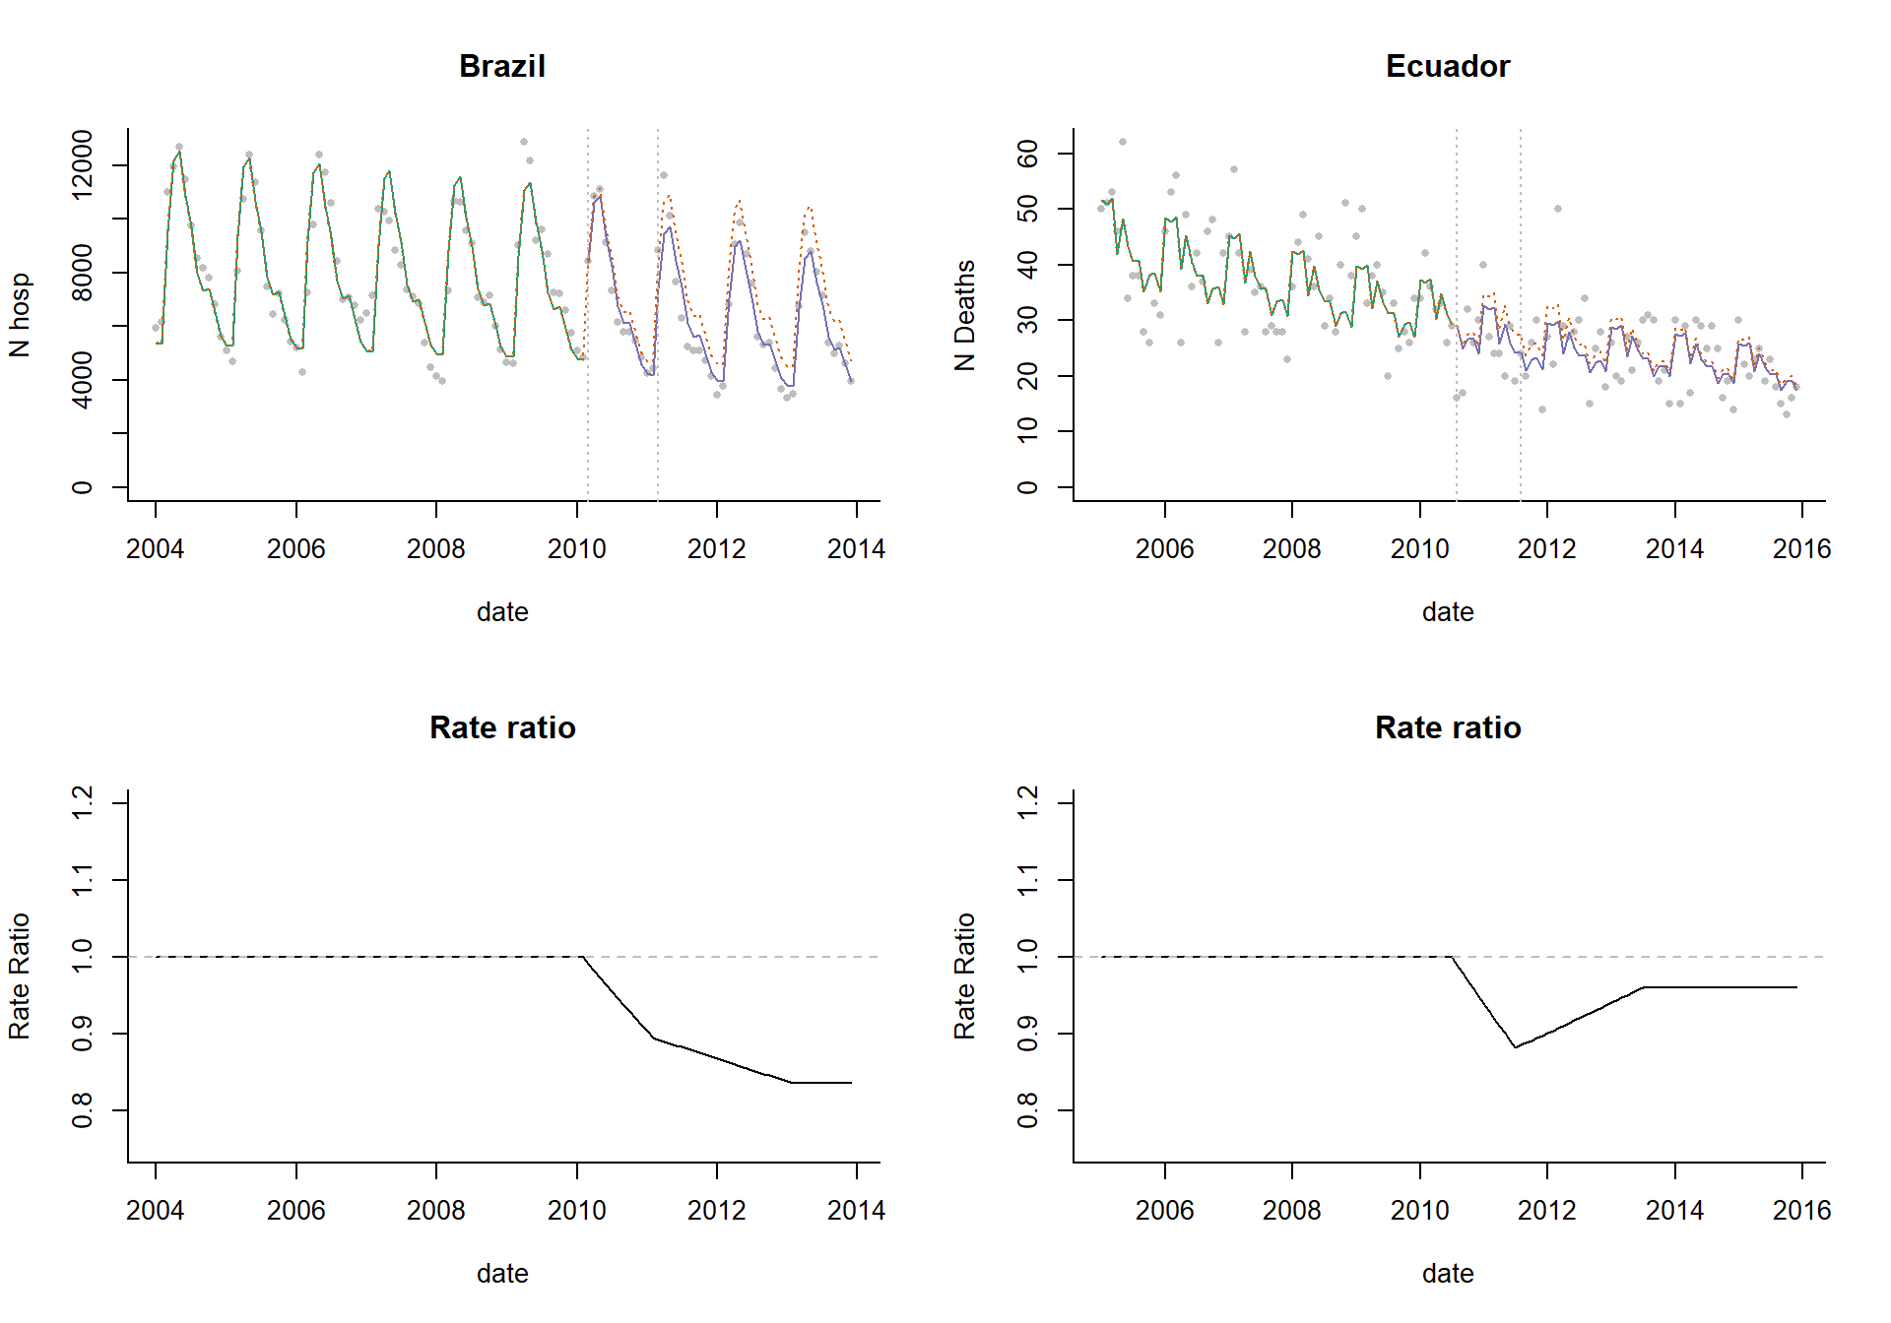
Quantifying the benefits of vaccination
Evaluating the direct effect of a vaccine
on an individual’s risk of disease
Evaluating the total impact of a vaccine
Captures both direct effects and indirect effects that result from blocking transmission
“Vaccine effectiveness”
Case-control studies (including test-negative design)
Ecological studies: Interrupted time series, synthetic controls…
V
V
V
V
V
V
V
V
Controls
Cases

Slide 6
What do we want to know?
How many lives were saved or cases prevented by introduction of the vaccine?
“Introduction of the pneumococcal conjugate vaccine was associated with the prevention of XX lives from 2010-2015”
How much did the vaccine reduce disease rates compared to baseline?
“Introduction of the pneumococcal conjugate vaccine was associated with a XX% reduction in the rate of invasive pneumococcal disease”

Slide 7
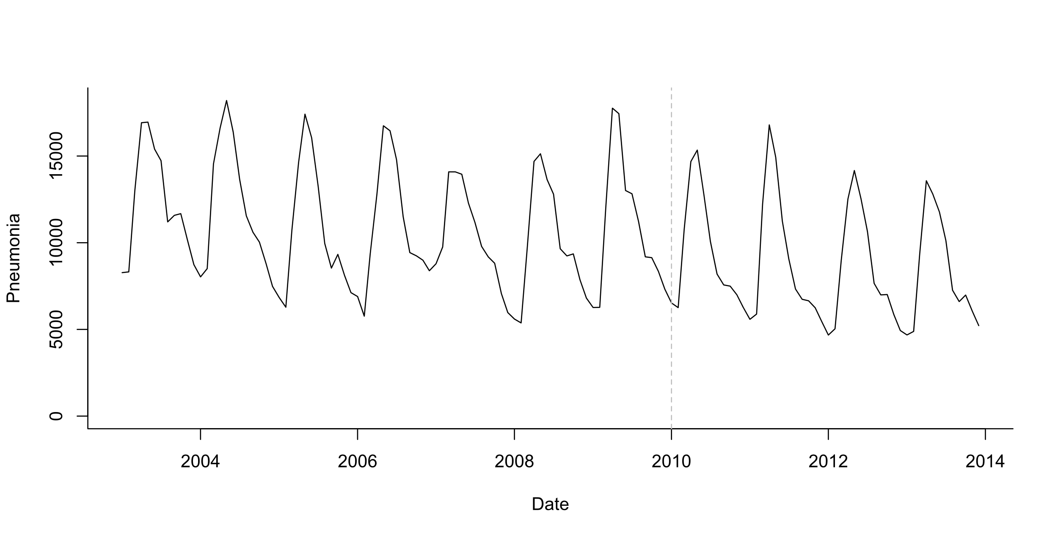
Time series
Number of cases per week/month/year
A monthly time series of pneumonia cases in infants in Brazil
Number of events
Time (in months)

Slide 8
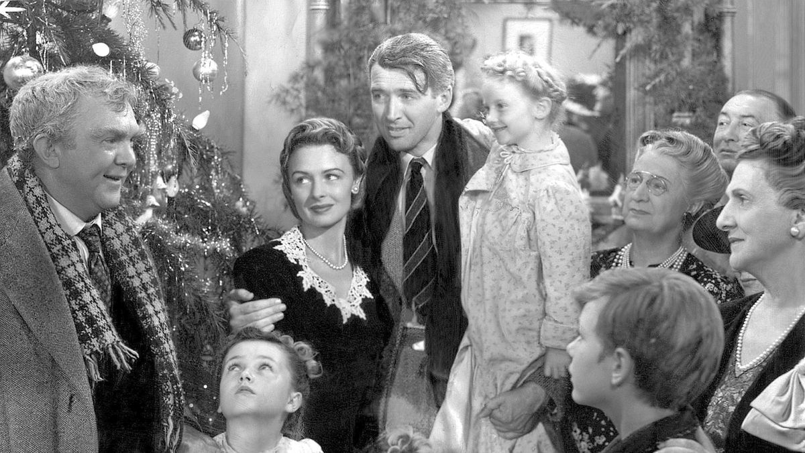
The major challenge: Estimating the counterfactual
“What would have happened if the vaccine had not been introduced?”
The counterfactual is based on extrapolations from the pre-vaccine period

Slide 9
Estimating the effect of a vaccine from a time series
Vaccine intro
“Counterfactual”
Vaccine effect
Pre-vaccine
Post-vaccine

Slide 10
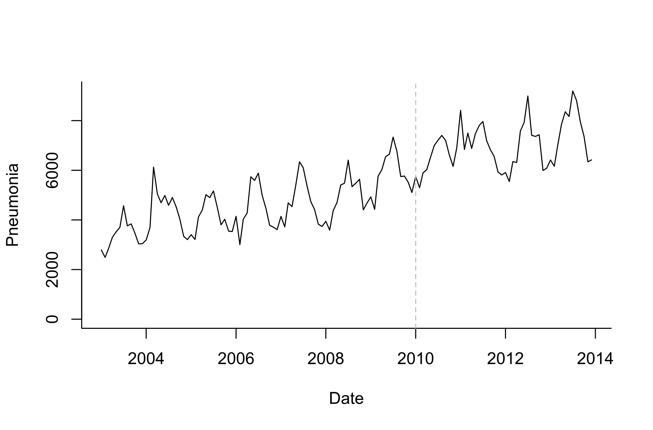
Estimating the effect of vaccine
?
Vaccine effect?
Pre-vaccine
Post-vaccine

Slide 11
Major types of analyses
Fit model to pre-vaccine period only,
then extrapolate
Fit model to full time series, compare
model fitted changes to extrapolated changes
Synthetic controls
ARIMA
Interrupted time series
Pre-post analysis
With adjustment
using controls
With comparison to controls
No controls

Slide 12
Some simple models, extrapolated from pre-vaccine data
Vaccine Impact= Observed vs expected over specified time intervals

Slide 13
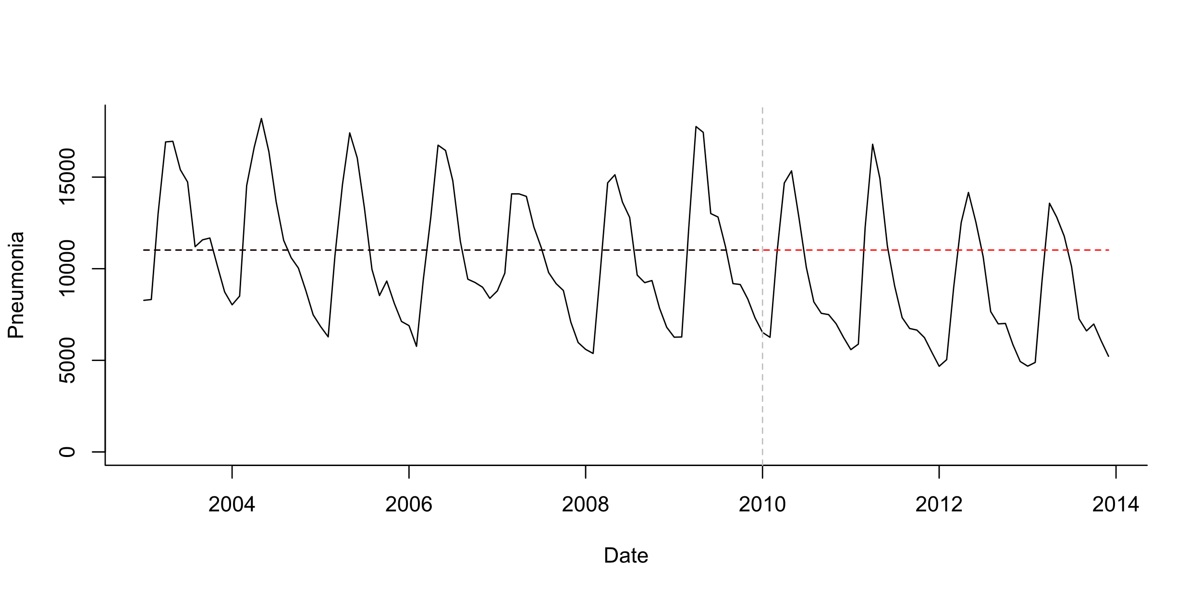
Pre-post analysis
Simple model:
Pneumonia_{t}~ Poisson(lambda_{t})
Log(lambda_{t}) = b0
Simplest case: stationary data ; no trends, no seasonality
Test whether mean number of cases declines post-PCV

Slide 14
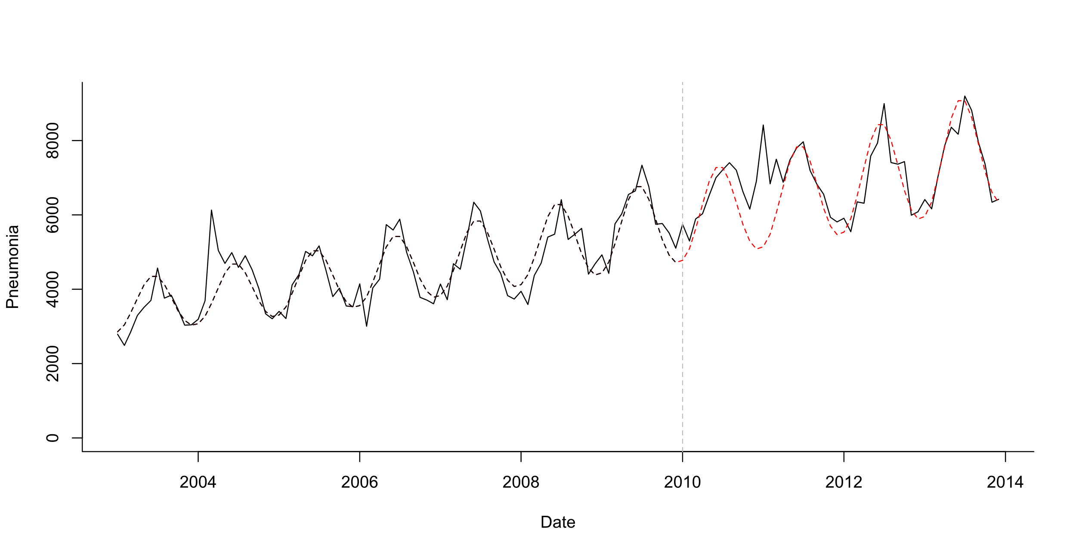
Controlling for seasonality
Harmonics
Monthly categorical variables
Estimates average in each month and adjusts expected value accordingly
Seasonal ARIMA (e.g., 12 month lags in the data)
Seasonal differences (X_{t} – X_{t-12})
Flexible spline functions

Slide 15
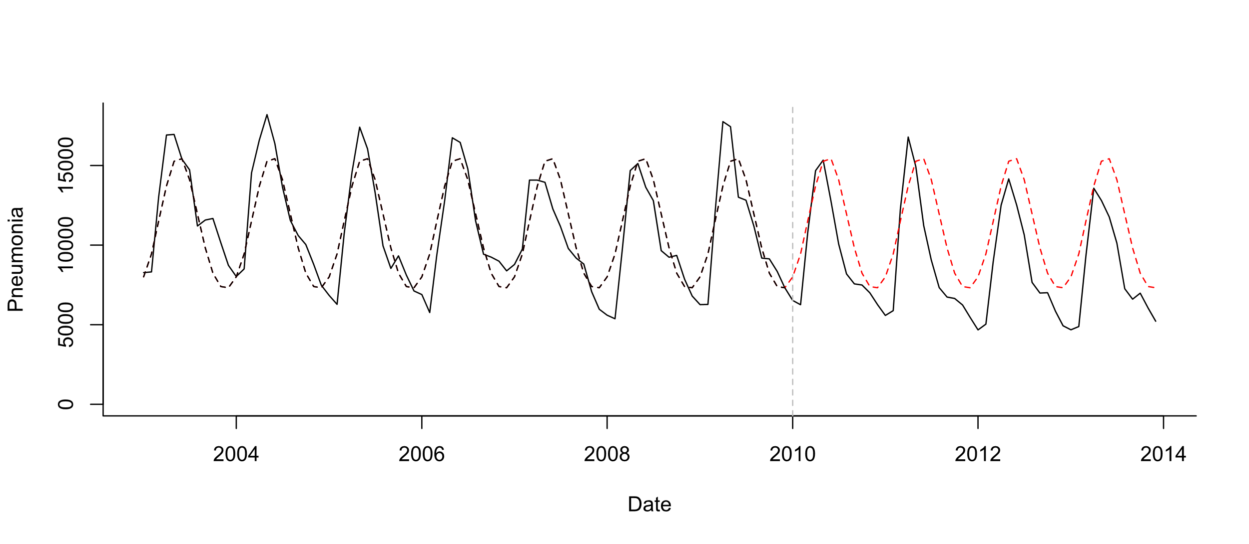
Pre-post analysis+seasonality
Seasonal model:
Pneumonia_{t}~Poisson(lambda_{t})
Log(lambda_{t})=b0 + b1*sin12 +b2*cos12

Slide 16
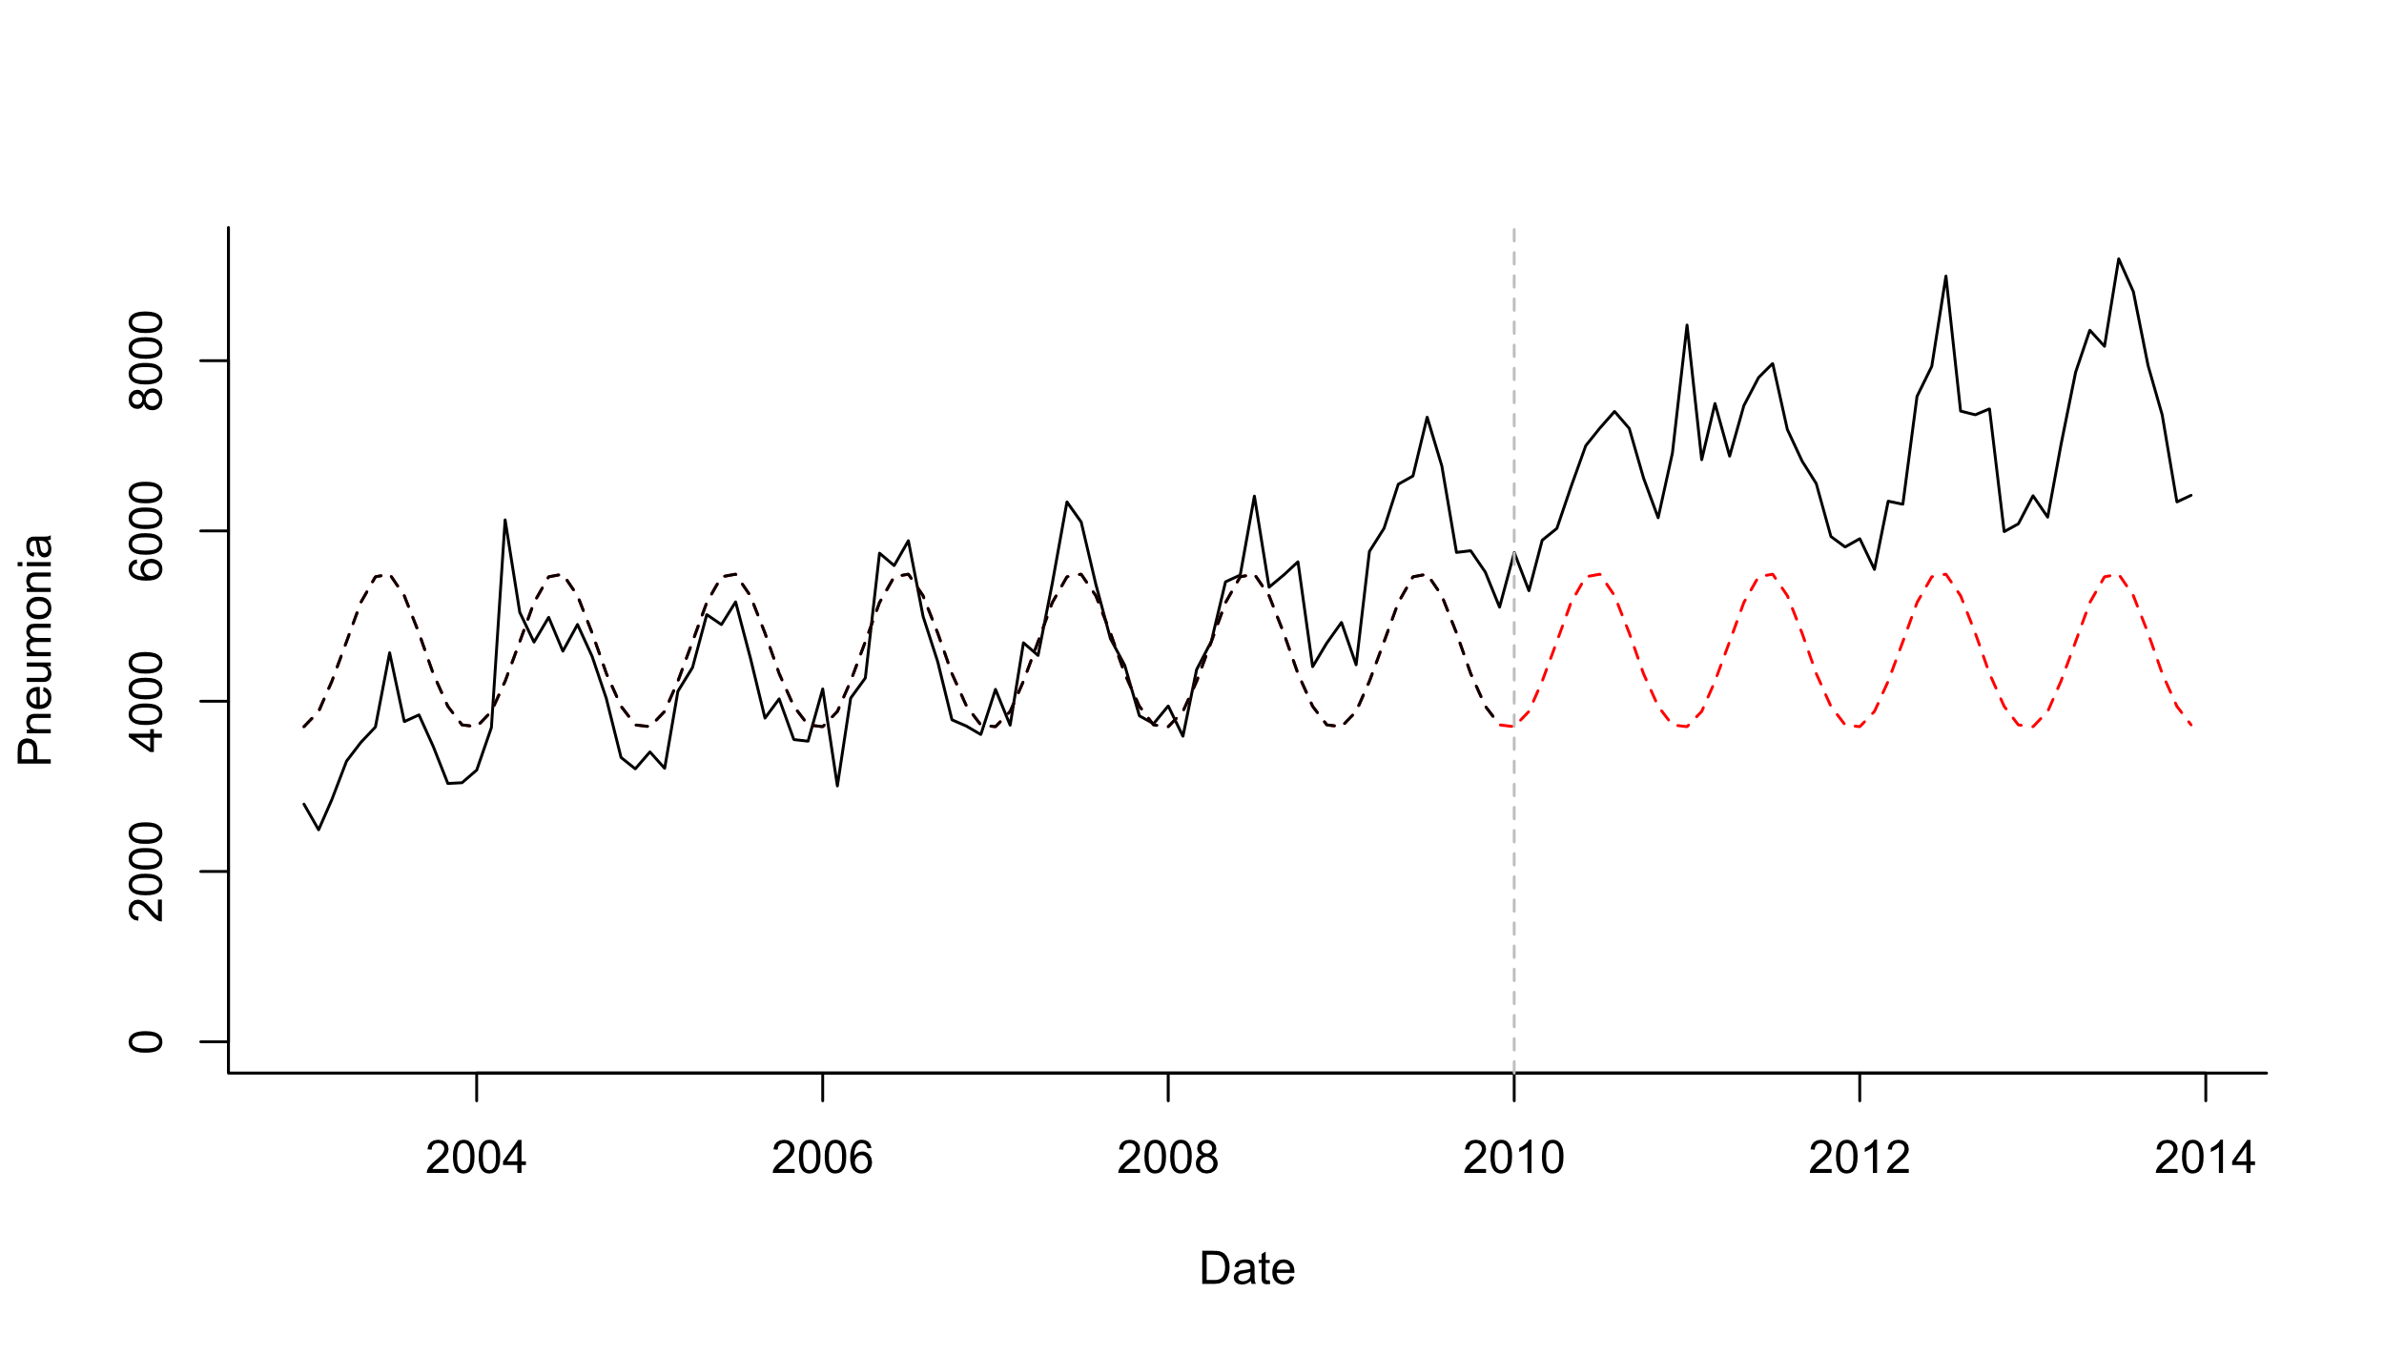
Pre-post analysis+seasonality
Seasonal model:
Pneumonia_{t}~Poisson(lambda_{t})
Log(lambda_{t})=b0 + b1*sin12 +b2*cos12

Slide 17
Pre-post analysis+seasonality + linear trend
Test whether mean number of cases declines post-PCV
Seasonal model:
Pneumonia_{t}~Poisson(lambda_{t})
Log(lambda_{t})=b0 +b1*sin12 +b2*cos12 +b3*trend
What is your evaluation period?
Last 2 years? Last 3 years?

Slide 18
Interrupted time series (ITS) models
Fit to the entire time series (pre and post)
Advantage: explicitly tests and quantifies the vaccine-associated change within the regression model
BUT:
Need to specify when change in disease rates will occur
Counterfactual is still effectively based on extrapolation from the pre-vaccine period
Vaccine Impact= Fitted value vs expected(Extrapolation) over specified time intervals

Slide 19
Testing for a change in trend within the model: Interrupted time series (ITS)
Fitted value at time t: lambda_{t}=exp(b+ a*t + c*z + d*t*z)
Counterfactual at time t: lambda_{t} =exp(b+a*t)
counterfactual
fitted
-Fit to the full time series (pre and post)
-“Does slope or level significantly change at time q”
- More useful: Estimate impact at each time point or in aggregate by cmparing fitted and counterfactual lines

Slide 20
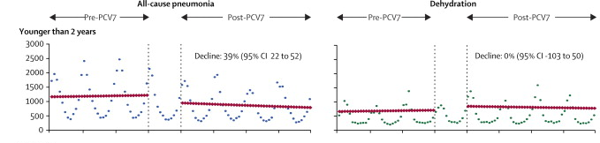
Evaluating impact of vaccines from time series
Counterfactual
Grijalva et al, The Lancet 2006
Pneumonia declines 39% compared to what would have been expected if not vaccine was introduced

Slide 21
Key challenge with ITS: Need to specify the time when the change(s) occur and the shape of that change

Slide 22
Specifying the time when the change occurred
Typically allow a period of time after vaccine rollout before you start estimating vaccine effect
Allows for ramp up of vaccination, disruption of transmission
Length of time depends on rate of vaccine rollout, age group being evaluated
Typically: at least 1 year; could be longer
If introduce a vaccine in infants and want to estimate indirect effect in adults, this might take several years, might need to wait until vaccinated kids age a bit
If do a very aggressive campaign to rollout (Cuba with PCVs), could use a shorter period

Slide 23
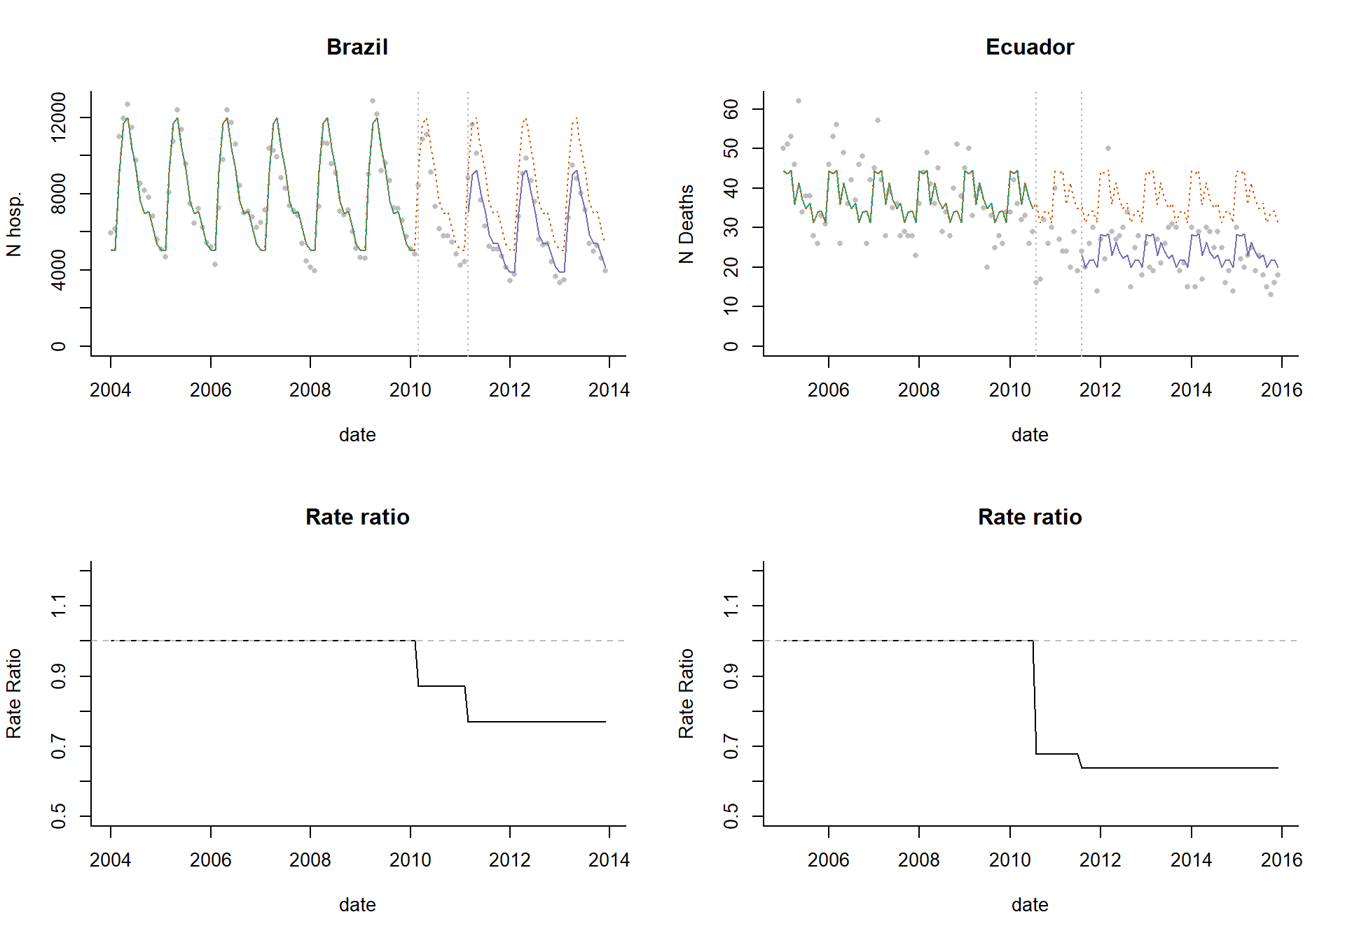
ITS with level change

Slide 24
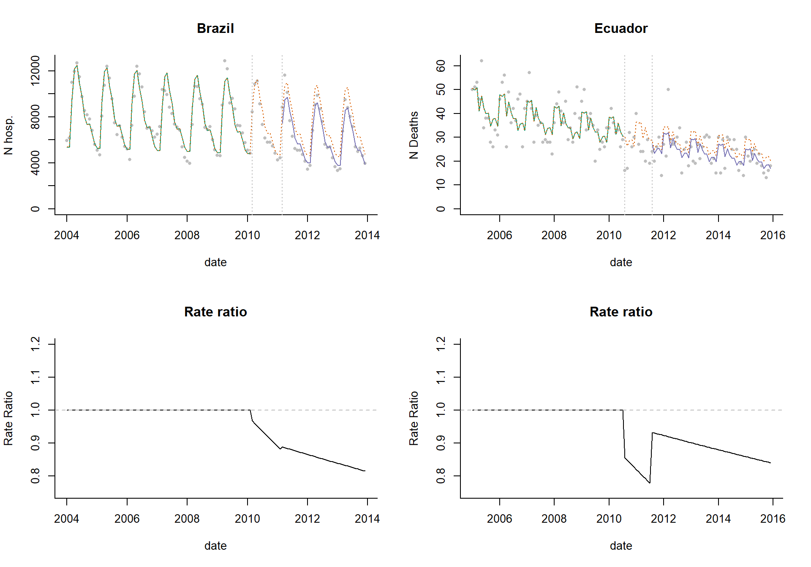
ITS with slope change and disjointed segments

Slide 25
ITS with connected segments

Slide 26
ITS with connected segments and leveling of slope

Slide 27
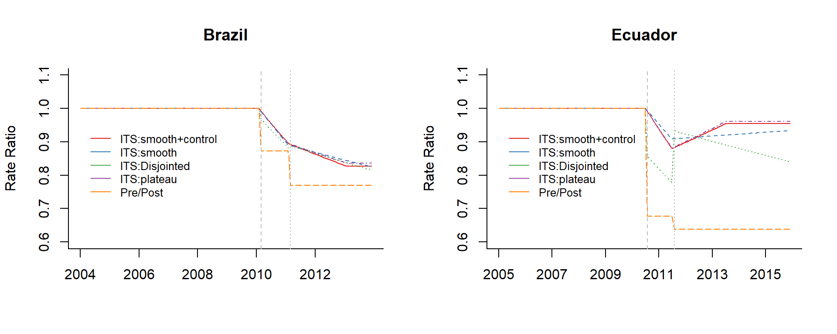
Sensitivity to choice of model depends on the data

Slide 28
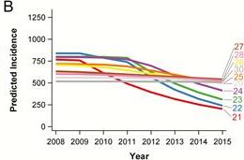
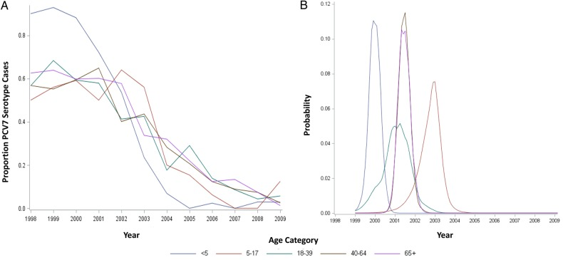
Building uncertainty about ITS change point into the analysis plan using Change Point Analysis
Declines in high grade cervical lesions by age and cohort
Timing of the decline in pneumococcal disease by age in the US
Niccolai et al CID
Pingali et al, JID

Slide 29
Think like an experimentalist
Never trust your main analyses without “pressure testing” it
Try different intervention dates—how does it influence your estimate?
Leaving out different seasons when fitting, see if it changes the answer
Perform simulations to see how likely it is that you would detect a decline
https://weinbergerlab.shinyapps.io/ITS_Poisson_Power/

Slide 30
What else could go wrong with analyses?
Epidemic before or after vaccine introduction (biases slope estimates)
ie 2009 pandemic, then introduce PCV in 2010
Insufficient data in pre- or post-period to accurately estimate trend
Unrelated changes that coincide with vaccine introduction
Delayed rollout of vaccine/low uptake
Many, many other issues that you can’t predict…

Slide 31
Ability to detect a vaccine-associated decline
Depends on:
Size of the expected decline (ie a 40% decline is easier to see than a 10% decline)
Amount of unexplained variability in the data
Length and quality of the pre-vaccine periods

Slide 32
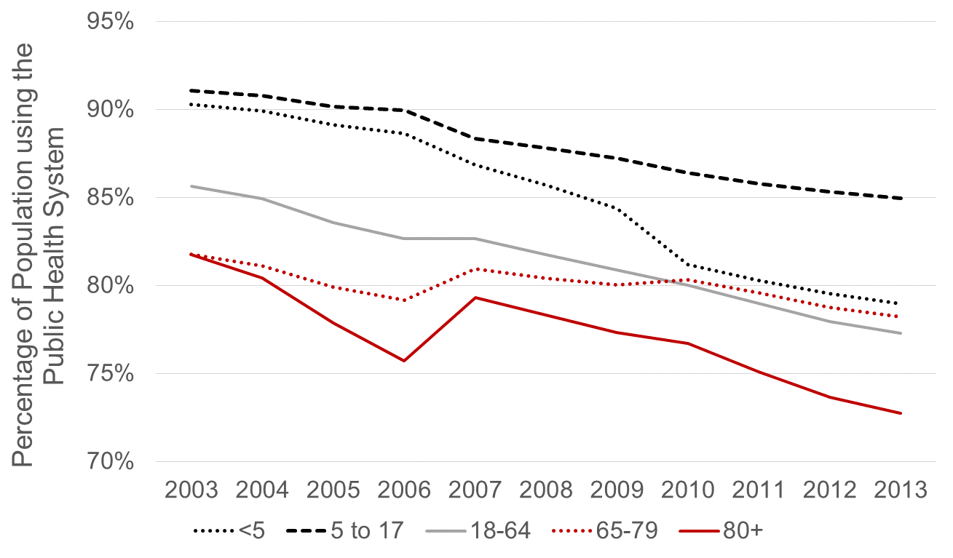
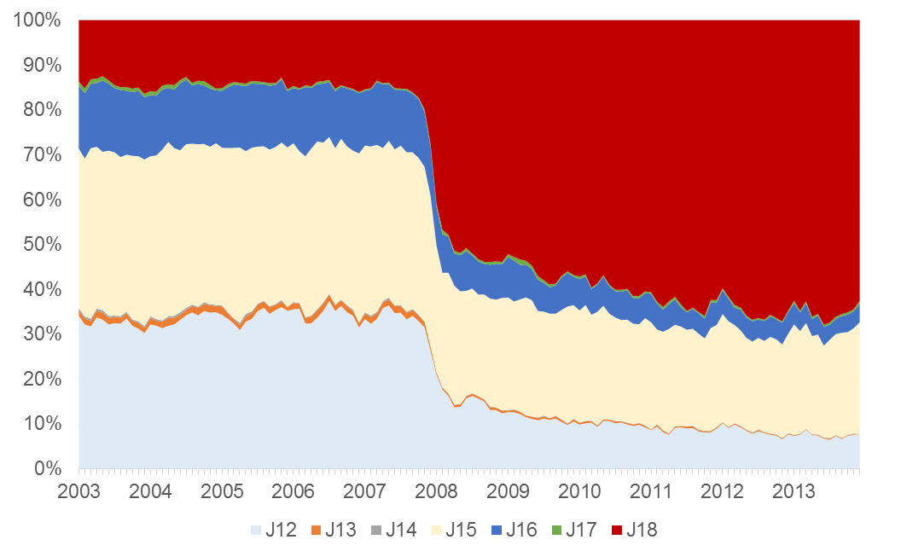
Changes in ICD coding practices
Changes in healthcare utilization
Other contributors to changes in underlying rates
Improvements to primary care reduce hospitalizations

Slide 33
There are a lot of factors aside from vaccination that influence disease or death rates. What do we do about it?

Slide 34
Use control diseases to detect/adjust for unrelated trends
Vaccine
Often used qualitatively
“Pneumonia declines but UTI is stable”
Can be used quantitatively
“Effect of PCV against pneumonia is X%-Y%”
Pneumonia
X% decline
Pre-vaccine
Post-vaccine
Time
Y% decline
Control disease
(e.g.UTI)
Pre-vaccine
Post-vaccine
Time

Slide 35
Using controls as an adjustment variable
Control disease
Model fit
Pneumonia
Pre-vaccine
Post-vaccine
Time
Step 1: Fit a regression model using data from the pre-vaccine data to establish a
relationship between pneumonia and a control disease
E.g., log(pneumonia)= b0 + b1*log(control disease)

Slide 36
Using controls as an adjustment variable
Control disease
Model fit
Pneumonia
Pre-vaccine
Post-vaccine
Time
Step 2: Plug in observed values for control disease from post-vaccine period to get an estimate for what counts of pneumonia would be

Slide 37
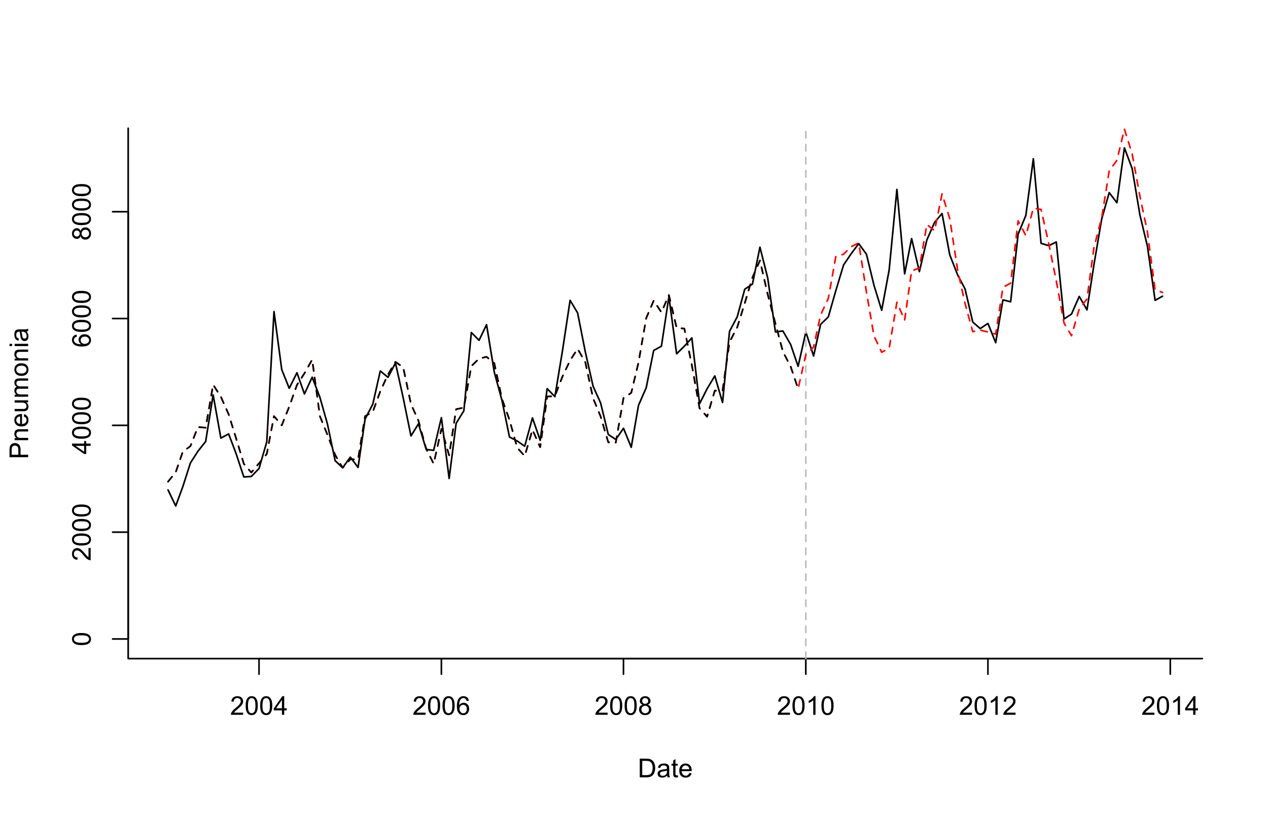
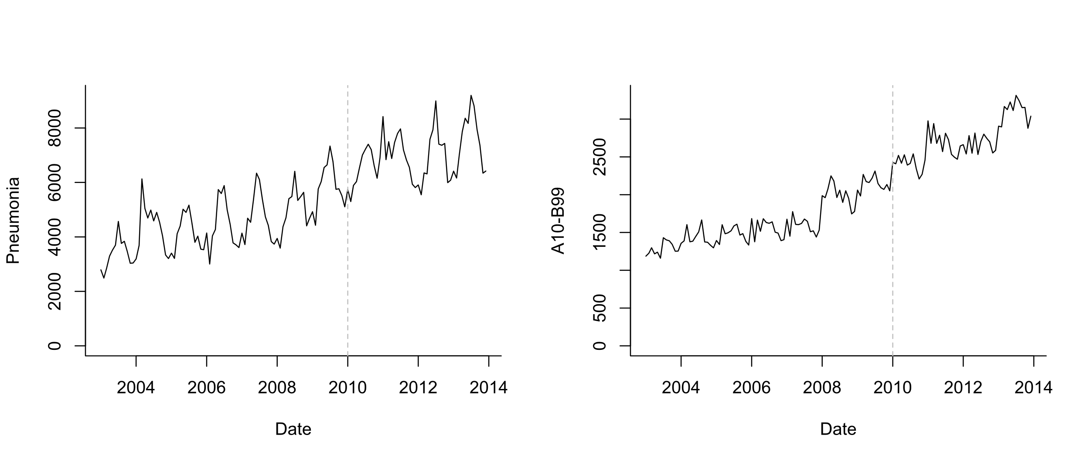
Possible control for pneumonia
Log(Pneumonia)=b0 +b1*sin12 +b2*cos12 +b3*log(A10_B99)
Model Fitting
Extrapolation based on controls

Slide 38
Key Assumptions
Relationship between pneumonia and control is stable over time and only change is due to the vaccine
Violated if there is an intervention that influences the control
Assumes control disease shares important non-vaccine trends with pneumonia
Vaccine does not affect control

Slide 39
What is a good control for pneumonia?

Slide 40
What has been used as a control for PCV impact against pneumonia?
Urinary tract infections
Acute event
Definitely not influenced by vaccine
Only influences some age groups
Different etiology
Fractures
Might capture some broad healthcare utilization patterns (?)
Definitely not influenced by vaccine
Very different risk factors, causal mechanisms from pneumonia
Bronchiolitis
Closest in etiology to pneumonia
Possibly influenced by the vaccine
Only occurs in certain age groups

Slide 41
The ideal control: Shares all causal factors, but is not influenced by vaccine
Regression: E(pneumonia cases_t)= b0 + b1*Perfect_control_t
The problem: how to identify a good control

Slide 42
Letting the data select controls
Method developed by Google for website analytics (Brodersen)
Select large number of candidate controls a priori
Use Bayesian variable selection to give more or less weight to specific control diseases in the final model
Log(Pneumonia)=b0 +b1*sin12 +b2*cos12 +b3*control1+ b4*control2+ b5*control3…

Slide 43
What does synthetic controls do?
Outcome
(all-cause pneumonia hospitalizations)
ICD-10: J12-18
Control diseases
Various ICD-10 codes
34 diseases
(Children <12 mo in Brazil is used as an example)

Slide 44
What does synthetic controls do?
Fit regression model to pre-vaccine data only
Test different control variables alone or in combination
In forward or backward variable selection, you would drop less important variables
With this approach (Bayesian variable selection), you never drop any variables, you just give them more weight
Gives you a regression model with a set of controls that do the best job at explaining trends in pneumonia pre-PCV
Extrapolate to post-PCV period based on changes in the control variables

Slide 45
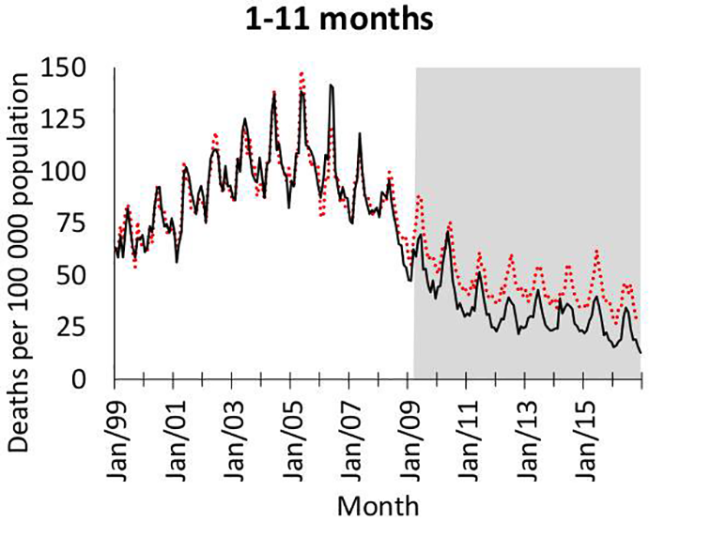
Example: Pneumonia in S Africa
Kleynhans et al PLOS Med

Slide 46
Synthetic Controls: Pros and Cons
Provides flexible and robust approach to estimate vaccine impact
2 strong assumptions
None of the controls are influenced by the vaccine
The relationship between pneumonia and the controls does not change over time
Modifications needed for optimal use in small populations
Doesn’t guarantee you will detect/adjust for all confounding, but it increases the chances of success

Slide 47
Which analytical method is best?
Using a control disease is critical
Avoid simple time trend adjustment with ARIMA or ITS
At a minimum, adjust for all-cause mortality/hospitalization
Pressure test results, compare and present multiple methods whenever possible

Slide 48
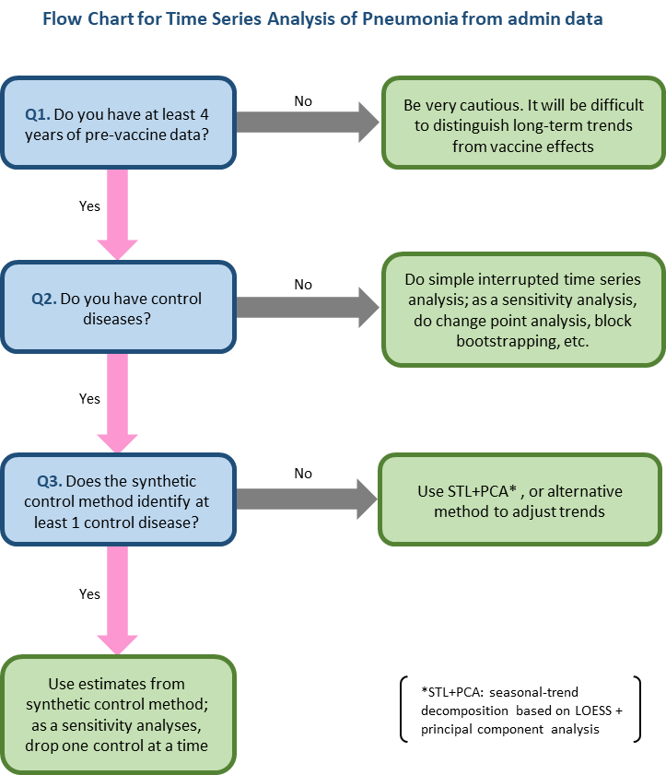
Dan Weinberger, PhD and Kayoko Shioda, DVM, MPH
Epidemiology of Microbial Diseases at Yale School of Public Health
How much pre/post vaccine data do you need?
--Figure it out with simulations:
https://weinbergerlab.shinyapps.io/ITS_Poisson_Power/

Slide 49
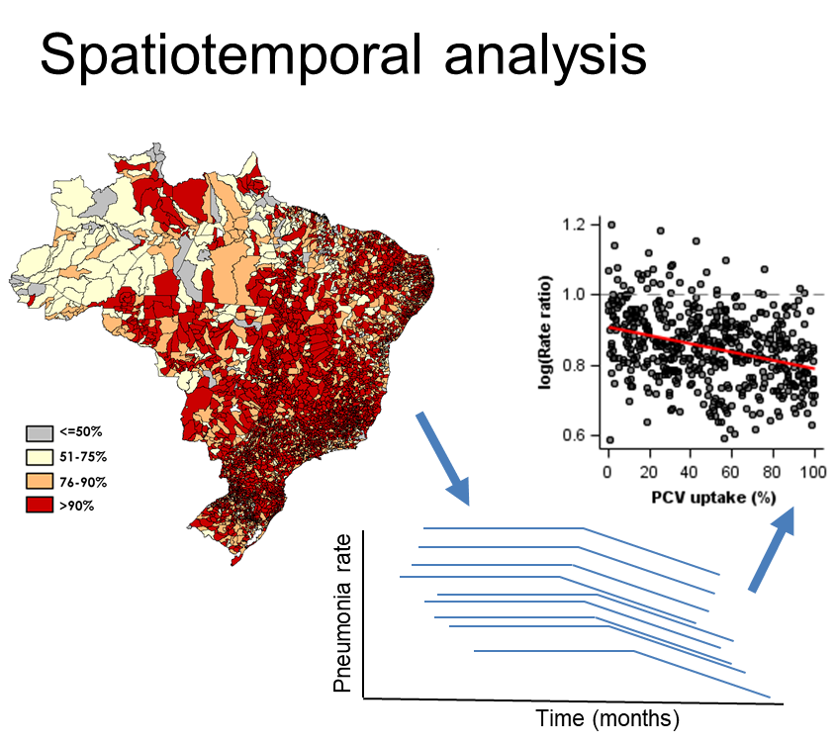
What if there is no good control?
For some diseases (varicella), controls not obvious
In these cases, we need to be especially careful in attributing changes to the vaccine
Can be strengthened by:
Change Point analysis: identify when change occurs relative to vaccine intro in different risk groups
Comparing changes across Risk groups/age groups when timing is expected to vary
Geospatial analysis: take advantage of variations in vaccine uptake and rollout

Slide 50
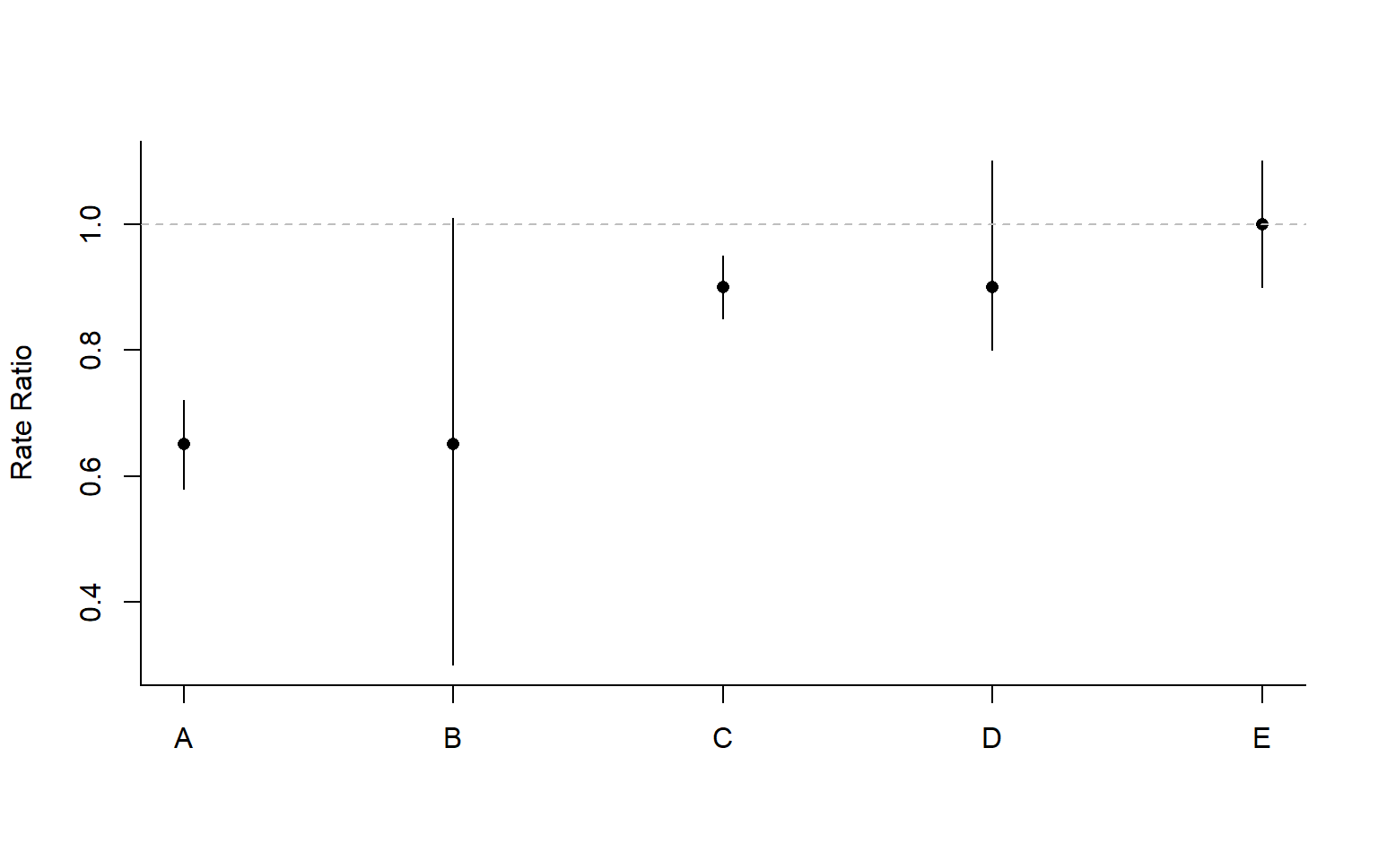
A final word: presenting results in light of uncertainty
The goal for impact evaluations is typically estimation of the effect size, not hypothesis testing
Focus on magnitude of estimate and uncertainty, not on ‘significance’

Slide 51
Resources
(Draft) WHO guidance on vaccine impact evaluation:
https://guidance.interventionevaluatr.com/
More extended version of this workshop (with videos, guided data analyses):
https://vaccineevaluationworkshop.github.io/

Slide 52
References to some of the papers discussed here
Synthetic Controls (Latin America): https://pubmed.ncbi.nlm.nih.gov/28154145/
Synthetic Controls (S Africa): https://pubmed.ncbi.nlm.nih.gov/33591995/
Changepoints (HPV): https://pubmed.ncbi.nlm.nih.gov/28520854/
Changepoints (PCVs): https://pubmed.ncbi.nlm.nih.gov/28767518/
Power calculations for ITS: https://pubmed.ncbi.nlm.nih.gov/33117962/
Spatial (Latin America): https://pubmed.ncbi.nlm.nih.gov/33447734/
Spatial change points (PCVs): https://pubmed.ncbi.nlm.nih.gov/27541841/

